Slide 1


Intel Unnati Industrial Training 2025
Project Title : Enhancing Customer Experience with AI-Driven Insights
Presented By : (Batch 4)
23951A66A3 – I. Mohan Phani Kishore 23951A66A4 – K. Mohana Rupa 23951A66A6 – K. Naga Harshita Department - CSE(AI&ML)
Date - 05-04-2025

Slide 2
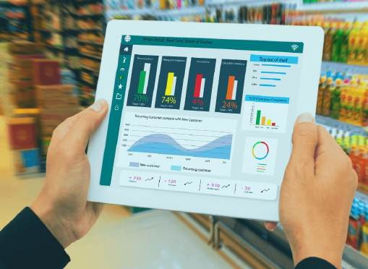
Introduction to Smarter Retail Experience
Brick-and-mortar retail stores are struggling to compete with e-commerce due to the lack of personalized in-store experiences.
Develop an AI-powered system that leverages real-time video analytics to track customer movement and behavior, providing valuable insights for store operations and customer engagement.
To create a smarter retail experience by offering personalized customer interactions and optimizing store performance through actionable insights.

Slide 3
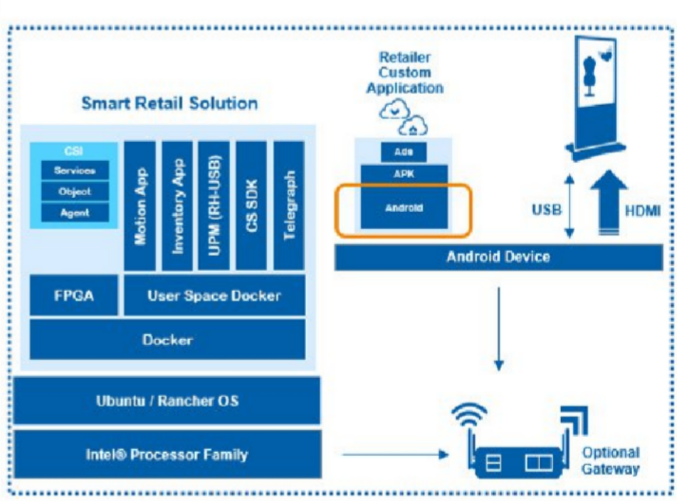
Objectives of the Project
Using in-store cameras to monitor customer movement and activities.
•Identify high-traffic areas, customer preferences, and patterns.
•Provide data-driven suggestions for product placement, promotions, and staff allocation.

Slide 4
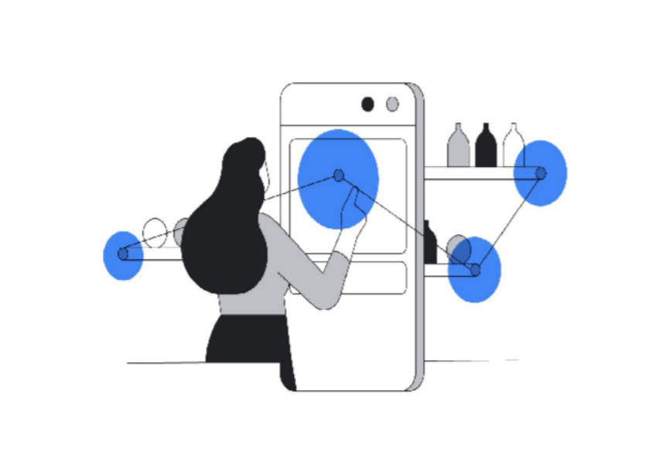
Overview of Project
•In-store cameras capture customer movement and behavior.
•AI algorithms process video data to generate insights in real time.
•Store managers receive actionable insights for enhancing the customer experience and improving operational efficiency.
•Personalized product placement and promotions.
•Alerts for customer assistance and restocking needs.

Slide 5
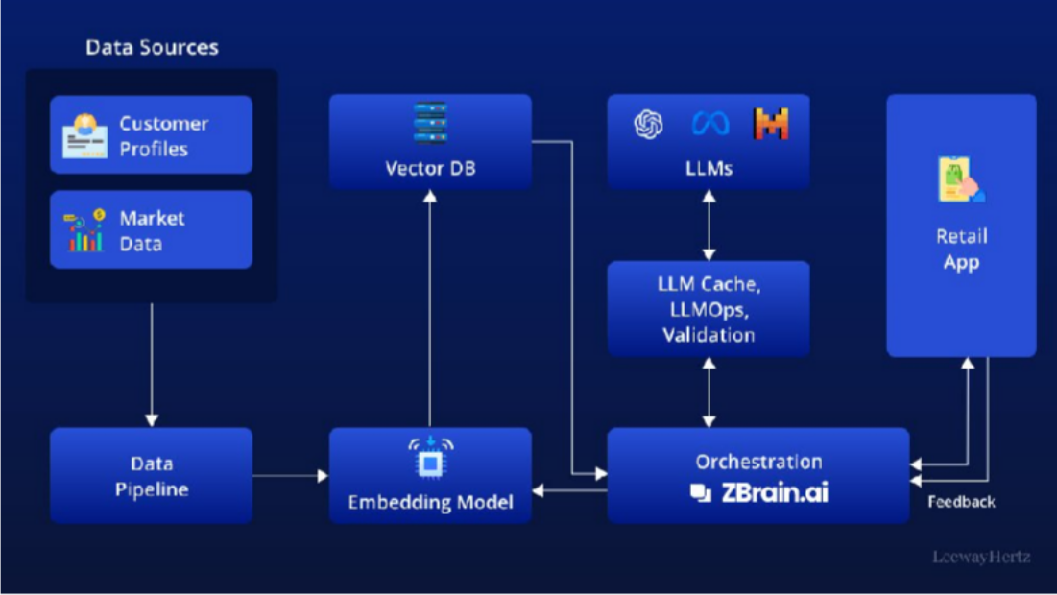
Components of the System
•In-store cameras and sensors for data collection.
OpenCV for video analytics, TensorFlow for AI modeling.
•Real-time data processing and actionable insights.

Slide 6
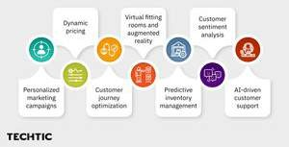
System Design Specifications
Input: Video feeds and sensor data from cameras.
Processing: AI algorithms analyze behavior and preferences.
Output: Real-time reports and alerts for store optimization.

Slide 7
Design and Algorithm
Object Detection (Customer Tracking): Use OpenCV and deep learning models (CNNs) to track customer movements in video feeds.
Behavioral Analysis: Implement clustering techniques to segment customer behavior into different patterns (e.g., browsing, purchasing).
Real-time Alerts: Build alert systems for when specific behaviors are detected, such as when a customer lingers near an out-of-stock product.
•Could include a flowchart of the algorithms or steps that are used to process the raw data from the cameras and sensors to the actionable outputs.

Slide 8

Software Stack
OpenCV: For real-time computer vision (e.g., detecting customer movement and tracking interactions).
TensorFlow/PyTorch: For training machine learning models that predict customer behavior and preferences.
Database (Optional): To store historical customer behavior data and patterns.
Visualization Tools (e.g., Tableau, Power BI): For presenting insights and alerts in an easy-to- understand format.

Slide 9
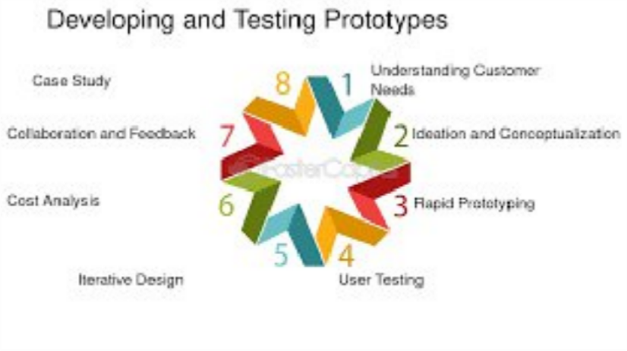
Prototyping and Testing
Prototype Features:
Real-time tracking of customer movement in the store.
Identification of high-traffic areas and product preferences.
Alerts for potential issues (e.g., restocking, customer assistance).
Testing Process:
Initial testing with video feeds in a controlled environment (e.g., smaller test store).
Evaluation based on accuracy of customer tracking, latency, and actionable insights.

Slide 10
Challenges and Solutions
Real-time Processing of Multiple Video Feeds
Accurate Behavior Detection in Crowded/Variable Lighting Conditions.
Handling Large-Scale Data Efficiently

Slide 11
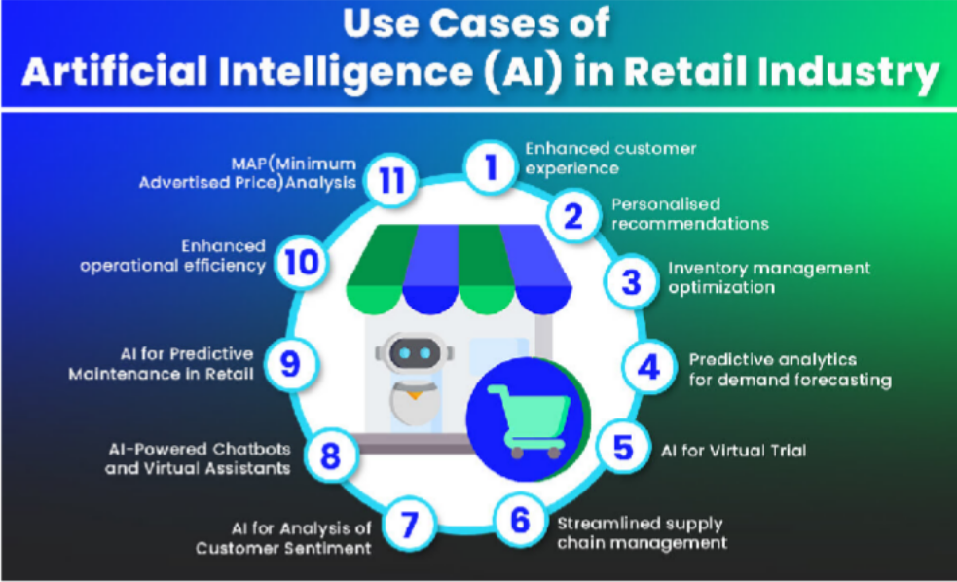
Case Study: Retail Implementation
Example Retail Implementation:
•Choose a real retail example or simulate one where this system is implemented.
Results:
•Through better product placement driven by real- time customer behavior insights.
•Personalization leads to higher customer satisfaction.
•Reduced out-of-stock incidents and better staff allocation.

Slide 12
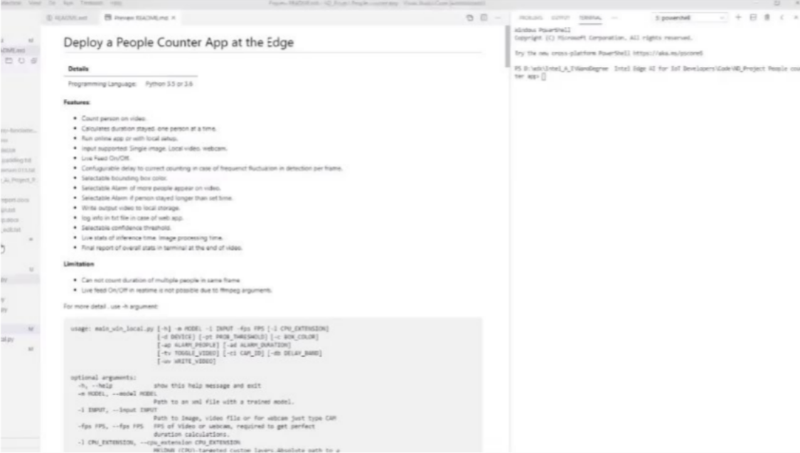
Results (Output)

Slide 13

Conclusion
AI and video analytics can significantly enhance the in-store customer experience.
Real-time insights lead to better operational decisions (e.g., product placement, restocking, staffing).
The system offers retailers a competitive edge over e-commerce by personalizing in- store shopping.
Future Potential: Mention how this technology can be expanded to larger stores or integrated with other retail tech.

Slide 14
References
Fei-Fei Li, ImageNet: A large-scale hierarchical image database, 2009.
Geoffrey Hinton, Learning representations by backpropagating errors, 1986.
Yann LeCun, Gradient-based learning applied to document recognition, 1998.
Rama Chellappa, Research on human activity recognition and video analytics.
Jitendra Malik, Research on object detection and scene understanding.

Slide 15
THANK YOU

